Slide 1


PROGRAMMING ON PYTHON
By Kulakov Denis

Slide 2



Introduction
Overview of Python:
High-level, interpreted language
Created by Guido van Rossum
First released in 1991
Key Characteristics:
Easy to read and write
Versatile and widely used
Supports multiple programming paradigms

Slide 3
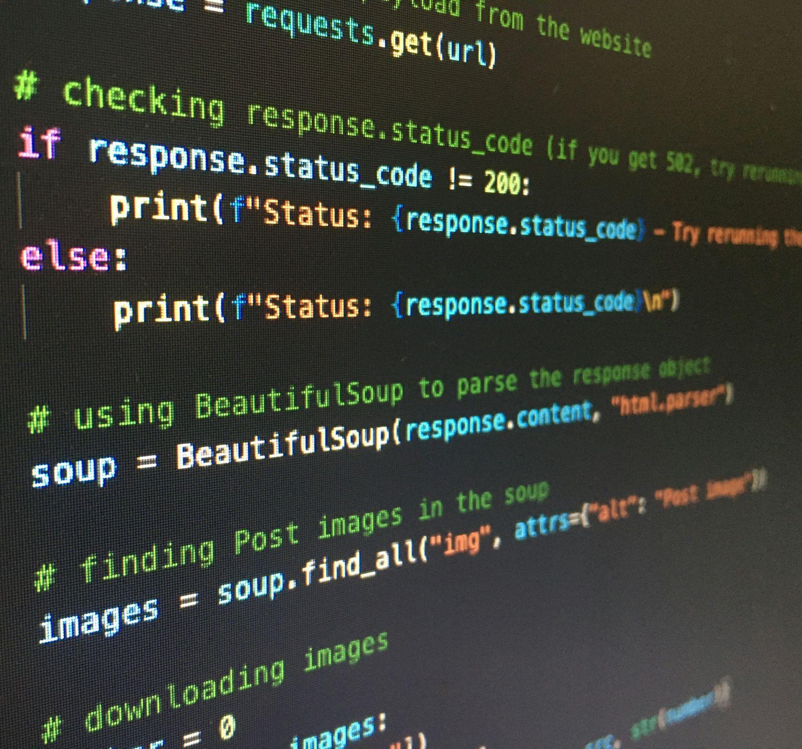





Applications of Python
Real-world Applications:
Web development (Django, Flask)
Data science (Pandas, NumPy, Matplotlib)
Automation (scripting, task automation)
Artificial intelligence (TensorFlow, scikit-learn)
Companies Using Python:
And many more!

Slide 4
Basic Python Concepts
Simple Calculator on Python
age = 21 # int temperature = 98.6 # float name = "Alice" # str is_student = True # bool # Basic Operations addition = a + b subtraction = a - b multiplication = a * b division = a / b # Comparison Operations equal = (a == b) # False not_equal = (a != b) # True greater = (a > b) # True less = (a < b) # False
operation = input("Choose operation (+, -, *, /): ") num1 = float(input("Enter first number: ")) num2 = float(input("Enter second number: ")) if operation == '+': print("Result:", num1 + num2) elif operation == '-': print("Result:", num1 - num2) elif operation == '*': print("Result:", num1 * num2) elif operation == '/': if num2 != 0: print("Result:", num1 / num2) else: print("Error: Division by zero") else: print("Invalid operation")

Slide 5
Data Structures in Python
# Add a new student's grade grades["Eve"] = 88 # Expected output: Student grades: {'Alice': 85, 'Bob': 90, 'Charlie': 78, 'Diana': 92, 'Eve': 88} # Update a student's grade grades["Alice"] = 95 # Expected output: Updated grades: {'Alice': 95, 'Bob': 90, 'Charlie': 78, 'Diana': 92, 'Eve': 88} # Set of unique student IDs student_ids = {101, 102, 103, 104} # Add a new ID student_ids.add(105) # Output: Student IDs: {101, 102, 103, 104, 105} # Try to add a duplicate ID student_ids.add(101) # Output: Student IDs after attempting to add duplicate: {101, 102, 103, 104, 105}
# List of student names students = ["Alice", "Bob", "Charlie", "Diana"] # Add a new student to the list students.append("Eve") # Output: List of students: ['Alice', 'Bob', 'Charlie', 'Diana', 'Eve'] # Tuple of coordinates (immutable) coordinates = (10.0, 20.0) # Output: Coordinates: (10.0, 20.0) # Dictionary of student grades grades = { "Alice": 85, "Bob": 90, "Charlie": 78, "Diana": 92 }

Slide 6

Functions and Modules
import math number = 16 square_root = math.sqrt(number) print(f"The square root of {number} is: {square_root}") # Output: The square root of 16 is: 4.0 # Importing the random module and generating a random number import random random_number = random.randint(1, 100) print(f"Random number between 1 and 100: {random_number}") # Output: Random number between 1 and 100: <random_number>
Functions are defined using the def keyword, allowing you to create reusable code blocks. They can take parameters as inputs and return values.
Modules are collections of related functions and variables. Python’s standard library includes modules like math for mathematical operations and random for generating random numbers.
numbers = [10, 20, 30, 40, 50] total = sum(numbers) count = len(numbers) average = total / count print(f"The average is: {average}") # Output: The average is: 30.0

Slide 7
Error Handling
Error handling allows programs to manage unexpected situations gracefully.
The try block lets Python attempt to execute code, and if an error occurs
The except block handles it.
For instance, catching a division by zero error prevents the program from crashing and allows displaying a user-friendly message.
The finally block ensures certain code runs regardless of an exception
Such as closing a file or releasing resources.
def divide_numbers(a, b): try: result = a / b except ZeroDivisionError: return "Error: Cannot divide by zero." finally: print("Execution completed.") return result num1 = 10 num2 = 0 print(divide_numbers(num1, num2)) # Output: Error: Cannot divide by zero.

Slide 8
Exercises
Contact Book:
Temperature Converter:
Number Guessing Game:
These hands-on tasks will help you apply the concepts we've discussed and give you a better understanding of how to use Python in real-world scenarios.
Develop a program to manage a contact book. Allow users to add, search, update, and delete contacts, with each contact containing a name, phone number, and email address.
Write a program to convert temperatures between Fahrenheit and Celsius. Create functions for the conversions and handle user input for the temperatures.
Implement a game where the user guesses a randomly selected number within a range. Provide feedback for each guess and track the number of attempts.

Slide 9
Self Check. Temperature Converter
def celsius_to_fahrenheit(celsius): return (celsius * 9/5) + 32 def fahrenheit_to_celsius(fahrenheit): return (fahrenheit - 32) * 5/9 def main(): print("Temperature Converter") choice = input("Enter 1 to convert Celsius to Fahrenheit or 2 to convert Fahrenheit to Celsius: ") if choice == '1': celsius = float(input("Enter temperature in Celsius: ")) print(f"{celsius}°C is {celsius_to_fahrenheit(celsius):.2f}°F") elif choice == '2': fahrenheit = float(input("Enter temperature in Fahrenheit: ")) print(f"{fahrenheit}°F is {fahrenheit_to_celsius(fahrenheit):.2f}°C") else: print("Invalid choice. Please enter 1 or 2.") if __name__ == "__main__": main()

Slide 10
Self Check. Contact Book
def main(): while True: print("\nContact Book Menu") print("1. Add Contact") print("2. Search Contact") print("3. Update Contact") print("4. Delete Contact") print("5. Exit") choice = input("Choose an option (1-5): ") if choice == '1': name = input("Enter name: ") phone = input("Enter phone number: ") email = input("Enter email address: ") add_contact(name, phone, email) elif choice == '2': name = input("Enter name to search: ") search_contact(name) elif choice == '3': name = input("Enter name to update: ") phone = input("Enter new phone number (leave blank to keep current): ") email = input("Enter new email address (leave blank to keep current): ") update_contact(name, phone if phone else None, email if email else None) elif choice == '4': name = input("Enter name to delete: ") delete_contact(name) elif choice == '5': print("Exiting Contact Book.") break else: print("Invalid choice. Please choose a valid option.") if __name__ == "__main__": main()
contacts = {} def add_contact(name, phone, email): contacts[name] = {"phone": phone, "email": email} print(f"Contact {name} added successfully.") def search_contact(name): contact = contacts.get(name) if contact: print(f"Name: {name}, Phone: {contact['phone']}, Email: {contact['email']}") else: print(f"Contact {name} not found.") def update_contact(name, phone=None, email=None): if name in contacts: if phone: contacts[name]['phone'] = phone if email: contacts[name]['email'] = email print(f"Contact {name} updated successfully.") else: print(f"Contact {name} not found.") def delete_contact(name): if name in contacts: del contacts[name] print(f"Contact {name} deleted successfully.") else: print(f"Contact {name} not found.")

Slide 11
Self Check. Number Guessing Game
import random def number_guessing_game(): lower_bound = int(input("Enter the lower bound of the range: ")) upper_bound = int(input("Enter the upper bound of the range: ")) # Ensure that the upper bound is greater than the lower bound while upper_bound <= lower_bound: print("Upper bound must be greater than lower bound. Please try again.") upper_bound = int(input("Enter the upper bound of the range: ")) secret_number = random.randint(lower_bound, upper_bound) attempts = 0 print(f"Guess the number between {lower_bound} and {upper_bound}") while True: guess = int(input("Enter your guess: ")) attempts += 1 if guess < secret_number: print("Too low! Try again.") elif guess > secret_number: print("Too high! Try again.") else: print(f"Congratulations! You guessed the number in {attempts} attempts.") break if __name__ == "__main__": number_guessing_game()

Slide 12



Brief summary of what we have discussed today
Python is one of the most readable and writable programming languages
Python is an object-oriented and functional language
And we also had some practice!
Python can be used for an incredibly large set of tasks ranging from AI to web applications
Python can handle errors and exceptions

Slide 13



Q&A

Slide 14
Follow us!
Thank you for your attention!
Find us online:
Tg: @fcs_hse
Vk: @cshse
cs.hse.ru

